Slide 1
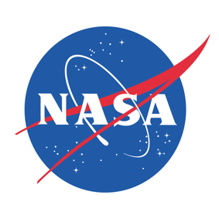
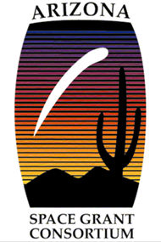
Diffusion of Biospecies within a Lung-on-a-chip Device
Victor Estrada in collaboration with:
Tim Frost and Dr. Yitzhak Zohar

Slide 2
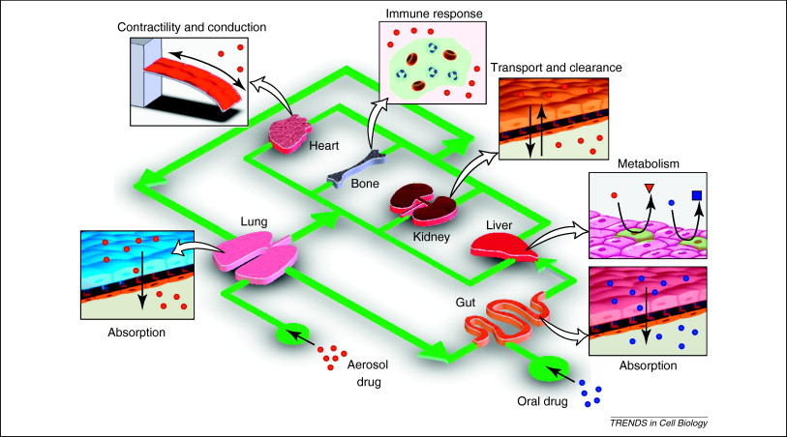
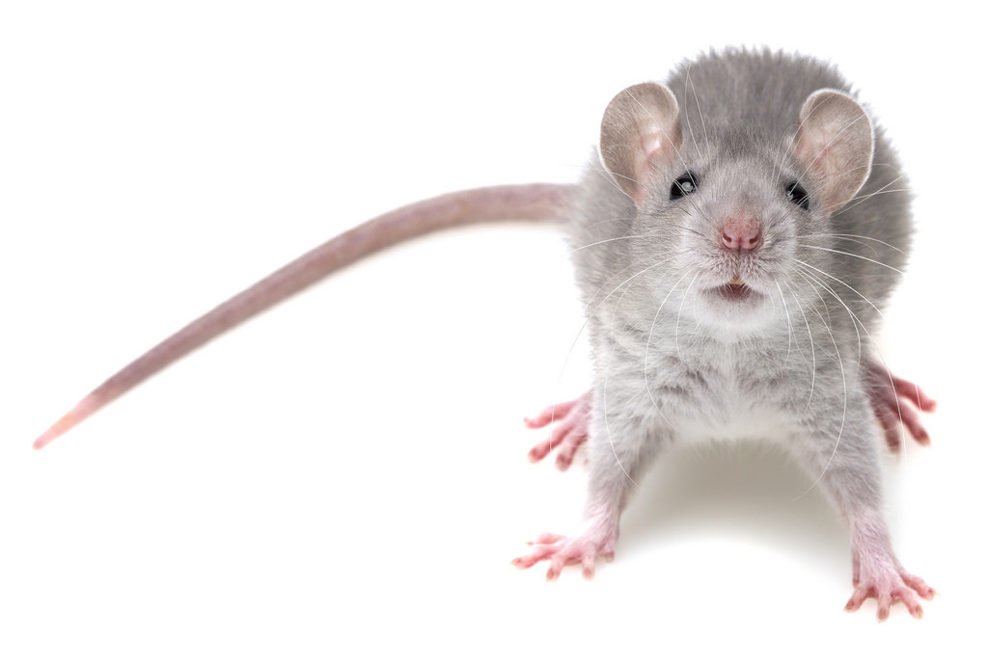
Project Motivation
Expensive, Inaccurate, and Unethical testing on animal models
Creating microfluidic “organs-on-a-chip”

Slide 3
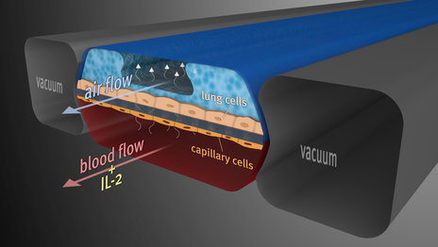
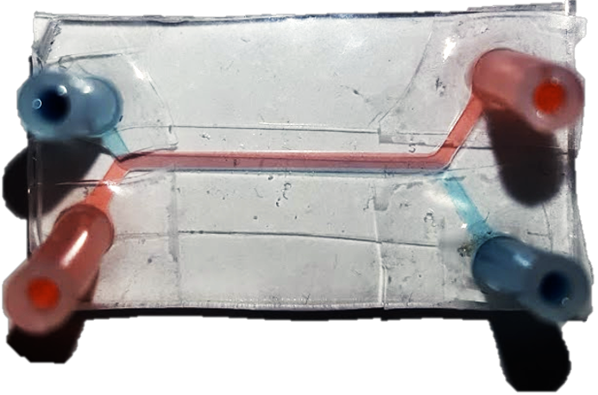
Description of a lung-on-a-chip device
4 cm
2 cm

Slide 4
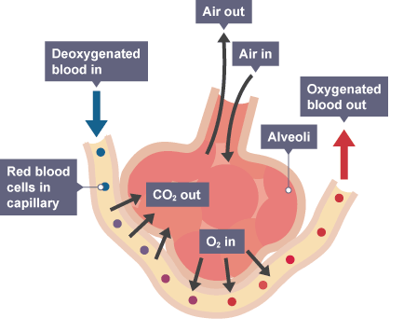
Goals
Determine what flow parameters influence the amount of diffusion the most:
  Flow rate
  Membrane Pore Size
  Molecule Size
  Flow Direction

Slide 5
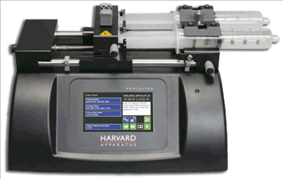
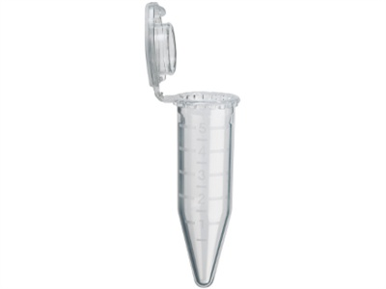
Experimental Setup
Pump
Micro-fluidic Device
Collection Containers
Two syringes are loaded. One with 100% concentration of certain fluorescent protein and the other at 0%
High concentration on top channel and low concentration on bottom channel
500 µl are collected from each channel in every trial

Slide 6
Flow Rate Results

Slide 7
Pore Size Results

Slide 8
Flow Direction Results

Slide 9
Conclusions
Flow rate is the most significant parameter that influences diffusion
Pore size also has a significant impact but it is less physiologically relevant than flow rate
The direction of the flow has virtually no effect
The size of the molecule has been seen to have a small effect however the results were not conclusive. More tests need to be conducted

Slide 10
Applications
This information will be used to better the understanding of absorption of drugs and diseases within microfluidic devices
This will also help further the relatively new field of microfluidics which has a lot of applications from biomedical engineering to aerospace engineering

Slide 11


Acknowledgements
Dr. Yitshak Zohar
Tim Frost

Slide 12
Thank you

